Slide 1
Lesson Three
Add Questions and Answers.
Dragos Rosca
Automatica si Calculatoare 2018

Slide 2
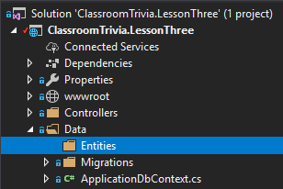
Adding Entities
In the folder data we will add a folder called Entities

Slide 3
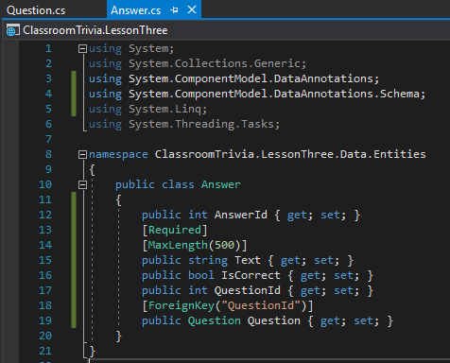
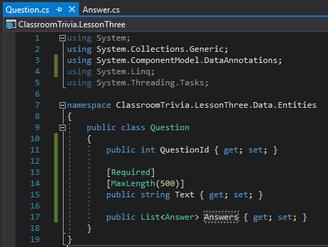
Adding Entities
In the Entities folder we will add our model classes.
Question
Answer

Slide 4
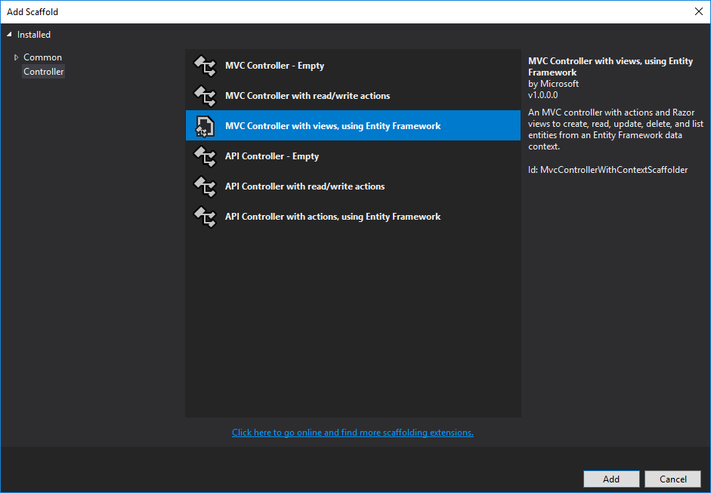
Adding Question Controller
On the Controller folder Add New Controller

Slide 5
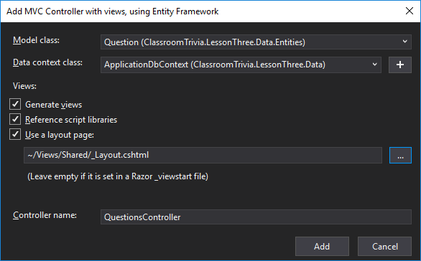
Adding Question Controller
Complete the fields for the QuestionsController

Slide 6
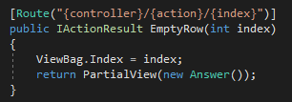
Adding Question Controller
In the QuestionsController add a new method to get an empty row for the answers list

Slide 7
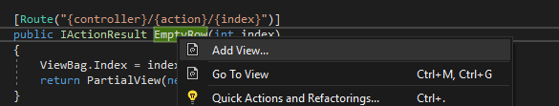
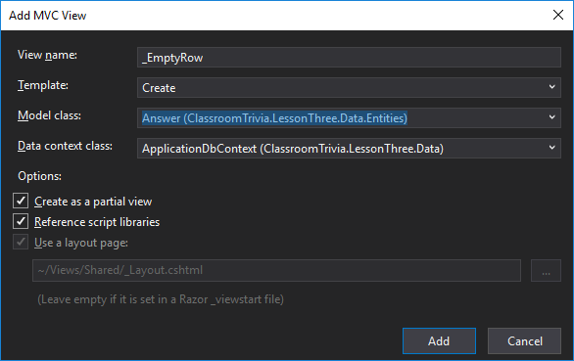
Adding Question Controller
On this method name right click and choose Add View…
On the Add View window fill in the fields

Slide 8

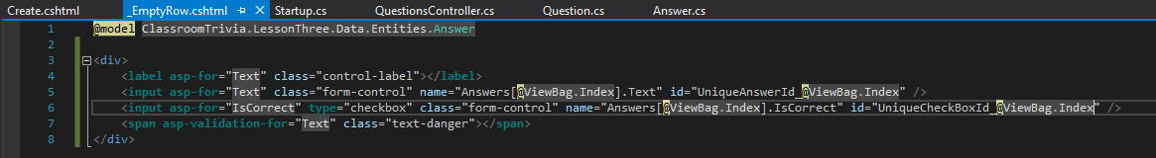
Adding Question Controller
In the new created partial view _EmptyRow delete everything except the first line
Fill in with the following code

